Slide 1
SONAR PREDICTION
BY
V.V.GANDHI
CH.MANJUSHA DEVI
G.PAVANI
Notes:
P

Slide 2
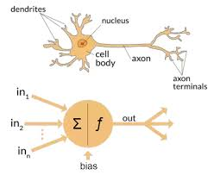
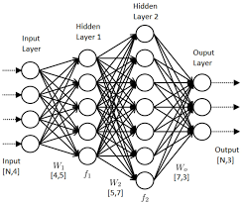
An Introduction To ANN(Artificial Neural Networks):
An Artificial Neural Networks is an information processing model that is inspired by the way biological nervous systems such as the brain, process information.

Slide 3
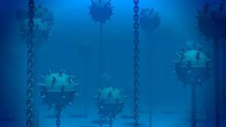
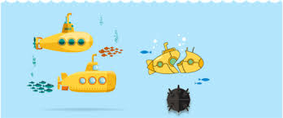
PROBLEM STATEMENT
Naval Mines:An naval mine is a self- contained explosive device placed in water to damage or destroy surface ship or submarines. Unlike depth charges, mines are deposited and left to wait until they are triggered by the approach of , or contact with , any vessel.

Slide 4
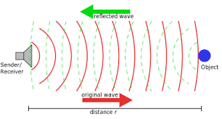
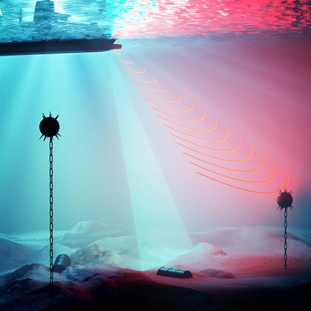
SONAR PREDICTION FOR NAVAL MINES DETECTION
SONAR(Sound Navigation And Ranging ):Sonar is A technique that uses sound propagation to navigate , communicate with or detect object on or under the surface of the water .

Slide 5
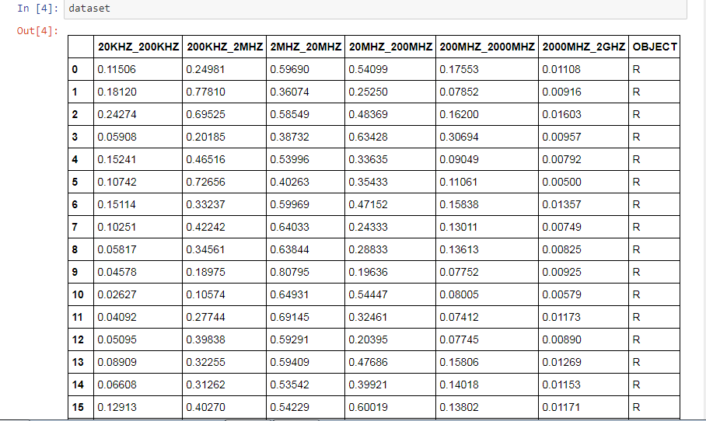
dataset:

Slide 6
STEPS IN THE PROGRAM
IMPORTING LIBRARIES AND DATASET
DATA PREPROCESSING
SPLITING DATASET INTO TEST AND TRAIN SETS
CREATING A MODEL
COMPILING OF MODEL
TRIANING THE MODEL
PREDICTING THE OUTPUT

Slide 7
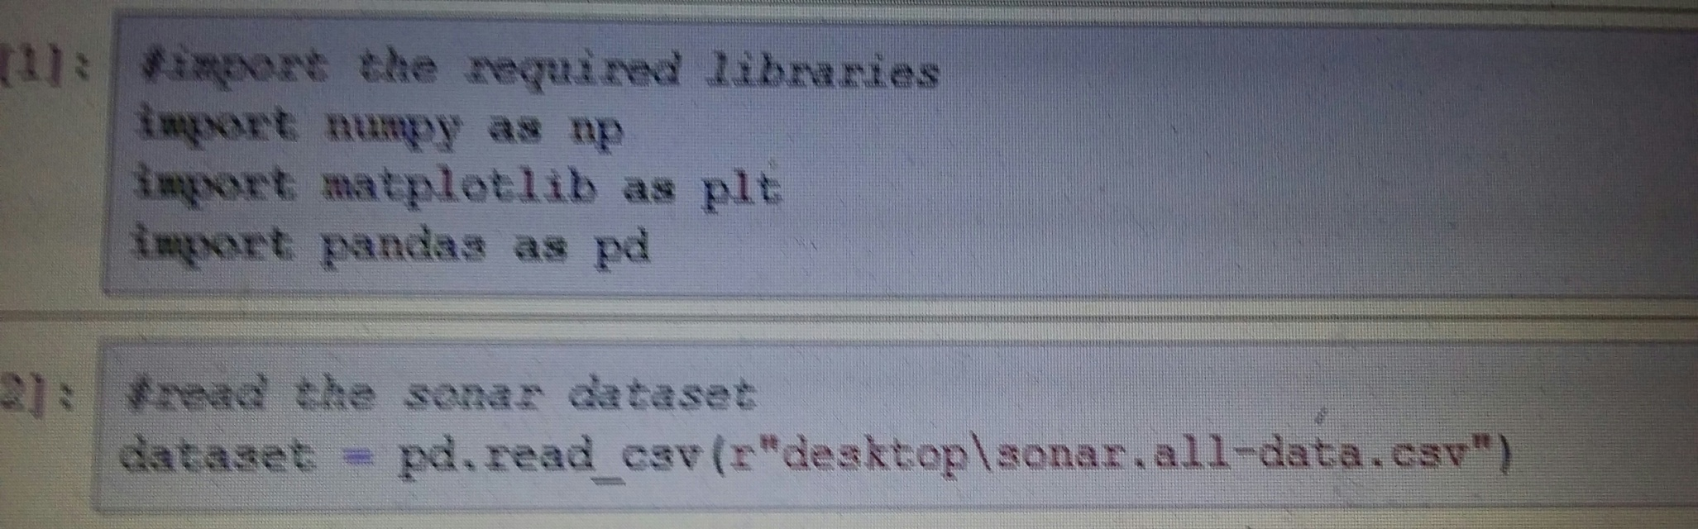
IMPORTING LIBRAIES AND DATASET
PANDAS: (PYTHON DATA ANALYSIS LIBRARY):- PANDAS IS OPEN SOURCE,BSD-LICENSED LIBRARY PROVIDING HIGH-PERFORMANCE ,EASY-TO-USE DATA STRUCTURES AND DATA ANALYSIS TOOLS FOR PYTHON.
NUMPY:NUMPY PROVIDES A HIGH-PERFORMANCE MULTIDIMENTIONAL ARRAY AND BASIC TOOLS TO COMPUTE WITH AND MANIPULATE THESE ARRAY.

Slide 8
DATA PREPROCESSING
DATA PREPROCESSING IS A DATA MINING TECHNIQUE THAT INVOLVES TRANSFORMING RAW DATA INTO AN UNDERSTANDABLE FORMAT.REAL WORLD DATA IS OFTEN IN COMPLETE ,INCONSISTANCE ,LACKING OF BEHAVIOUR.
STEP-1 : SEPARATION OF INDEPENDENT AND DEPENDENT DATA.
STEP-2 : LABEL ENCODING

Slide 9
SPLITING DATA INTO TRAIN AND TEST:
We are training the data at 80% and test as 20%.
STANDARD SCALER OF THE DATA
Standardize the data.

Slide 10
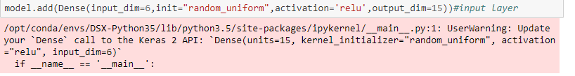
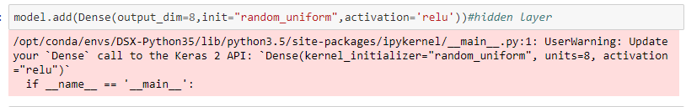
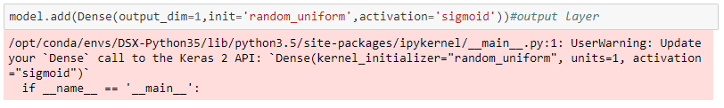
CREATING A MODEL

Slide 11
MODEL COMPILATION
ONCE THE MODEL IS DEFINED IT IS NEED TO BE COMPILED THIS CRAETES THE EFFICIENT STRUCTURES USED BY THE UNDERLYING BACKEND IN ORDER TO EFFICIENT EXECUTE THE MODEL DURING TRAINING.

Slide 12
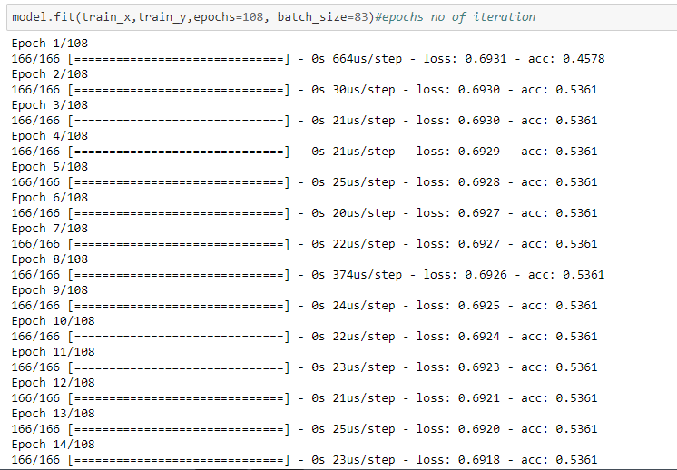
TRIANING THE MODEL
THE MODEL IS TRIANED ON NUMPY ARRAY USING THE fit() FUNCTION
IT HAS TWO SPECIFICATION 1)NO.OF.EPOCHS 2)BATCH SIZE
EPOCHS IS THE NO.OF .TIMES THAT THE MODEL IS EXPOSED TO THE TRAINING DATASET
BATCH SIZE IS THE NO.OF.TRAINING INSTANCES SHOWN TO THE MODEL BEFORE A WEIGTH UPDATE IS PERFORMED

Slide 13
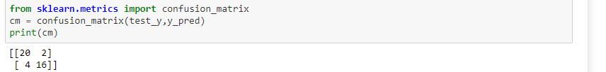
MODEL PREDICTION
WE CAN USE MODEL TO MAKE PREDICTION ON TEST DATA OR NEW DATA
model. Predict():- IS METHOD USED GENERATE NETWORK OUTPUT FOR INPUT DATA

Slide 14
APPLICATIONS
TO DETECT ,TRACK AND DESTROY THE ENEMY SHIPS AND THE SUBMARINES
TO COMMUNICATE USING UNDERWATER AS AN MEDIUM
TO NAVIGATE UNDER ICEBERGS
FOR FISH FINDING

Slide 15
CONCLUSION:
INORDER TO MINIMISE DESTRUCTIONS CAUSED BY ENEMIES AND TO KNOW THE OBJECTS ON THE SURFACE OF THE WATER AND ALSO TO PREDICT WHETHER ANY ROCKS OR THE MINES PRESENT.

